Slide 1
October 2021 Target Achievement Plan
October 2021 Target | 01-10 Oct Achievement | GAP | 11-20 Oct Sell Out Plan | 21-30 Oct Sell Out Plan
1500 | 258 | 1242 | 700 | 542
Need To Support From Company
(4GB+64GB) Products Available
(4GB+128GB) Products Available
Incentive plan for GRT & RSC Shop

Slide 2
Dealer Plan
Lifting Target | 01-10 Oct Achievement | GAP | 11-20 Oct Lifting | 21-30 Oct Lifting
1600 | 205 | 1395 | 800 | 595
Ensure DSR visit every route everyday
Ensure Dealer 30 days stock available model wise
Ensure Core Retailer High Range Product 100% WOD
Due support some retail for GT master & 8(5G)
Discount support for 8(5G)

Slide 3
My Plan For Target Achievement
Follow Up RSC & Force Daily Target Achievement
Follow Up GRT Shop For Sell Out
Retail Wise Check WOD & Fill Up Gap Immediately
Follow Up Daily Sell Out Target VS Achievement
Highest Target Achievement RSC & GRT Reward Plan
Build Up Relation With Low Selling Retailer
Try To Ensure 100% Retail Model Wise Product Placement

Slide 4
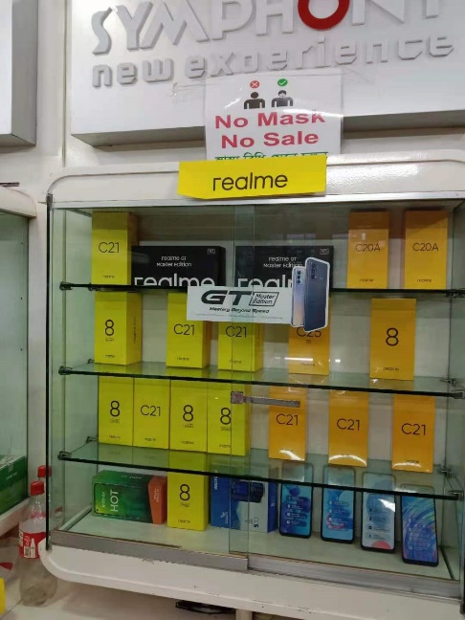
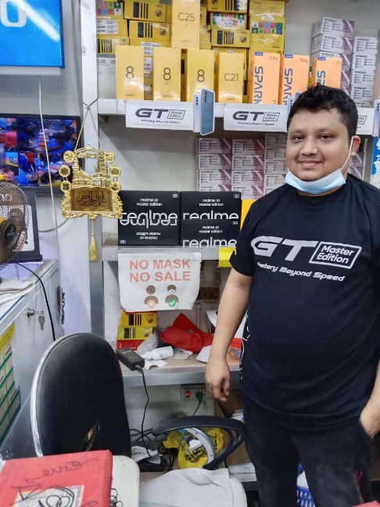
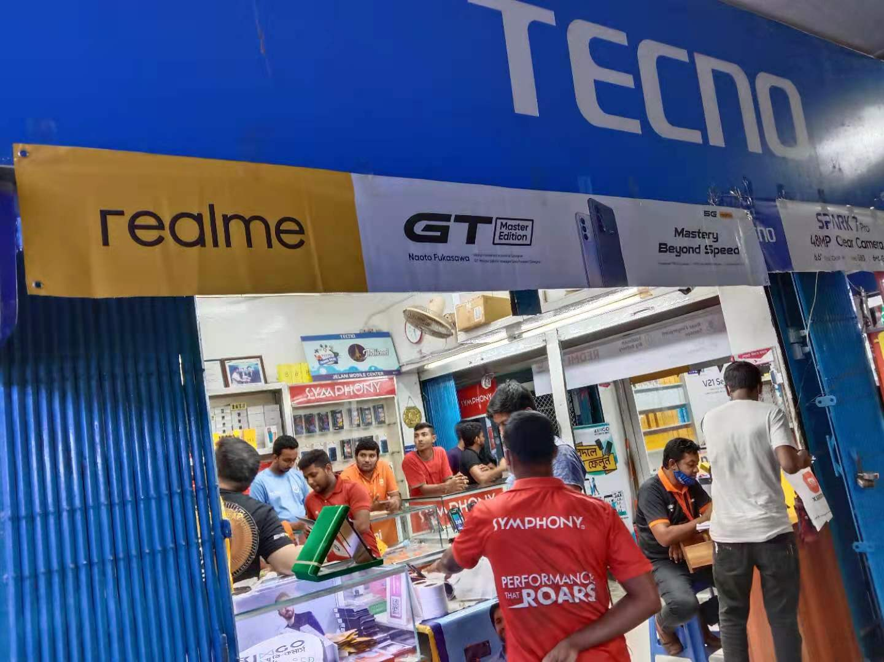
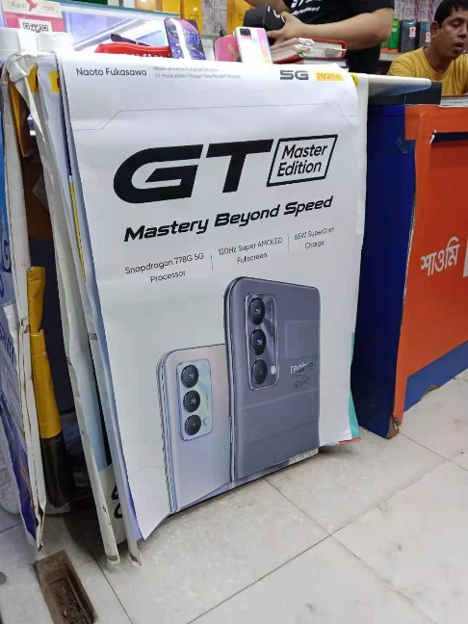
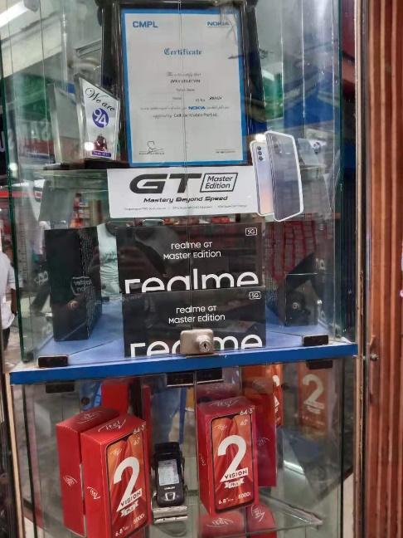
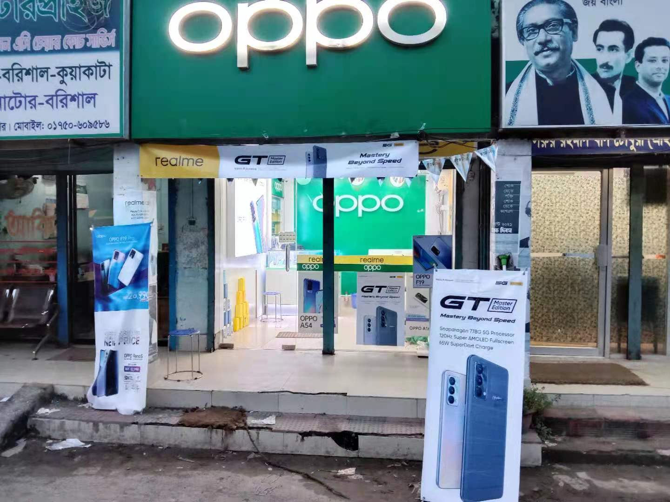
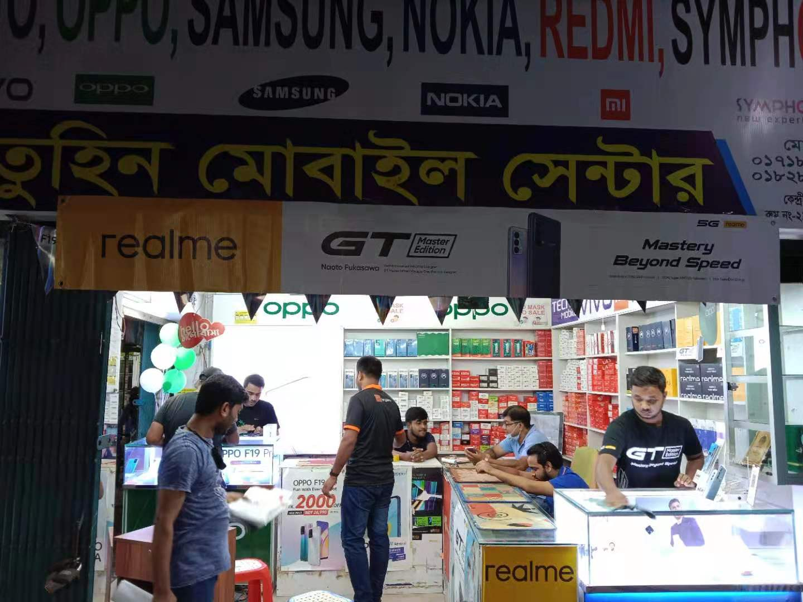
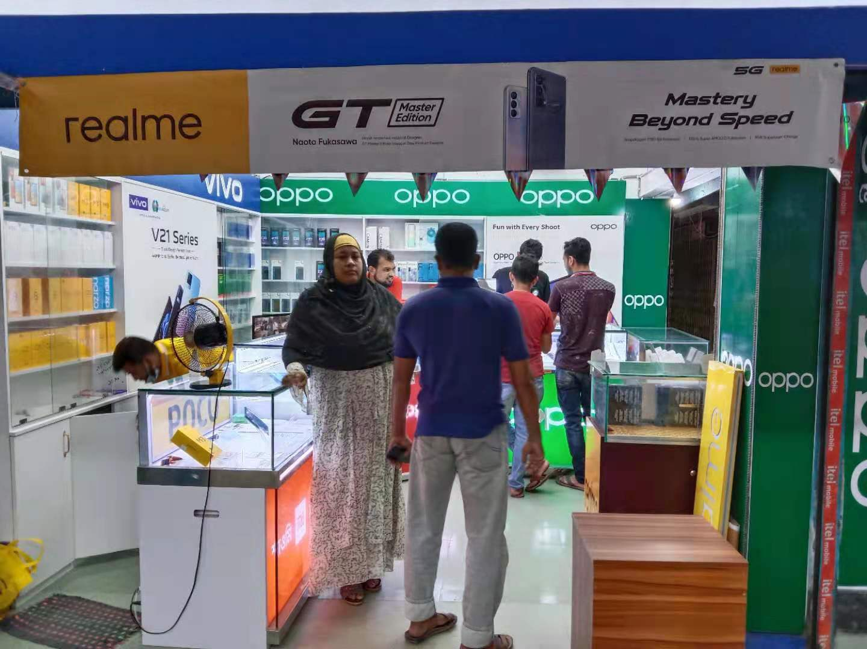
POSM Execution Picture

Slide 5
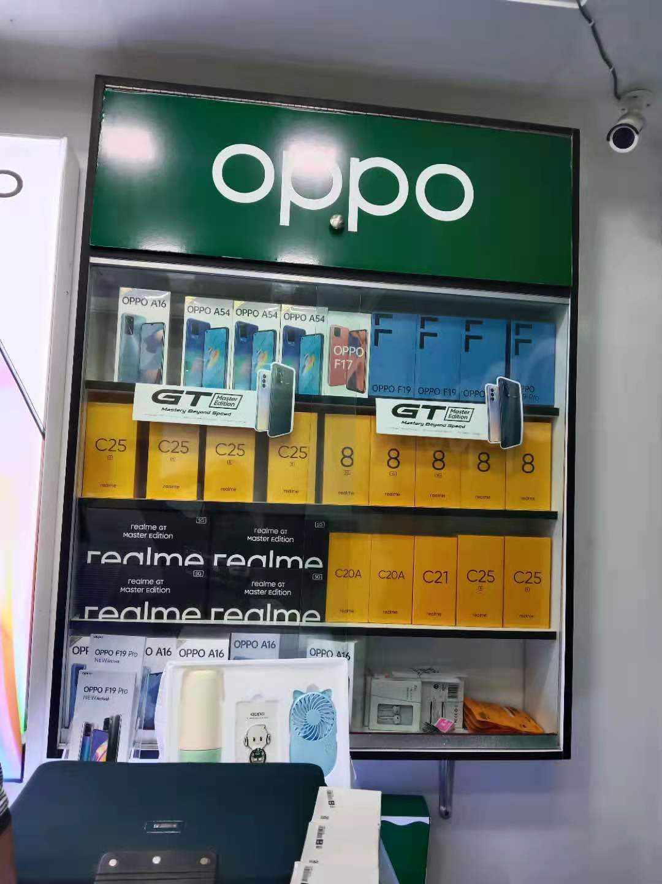
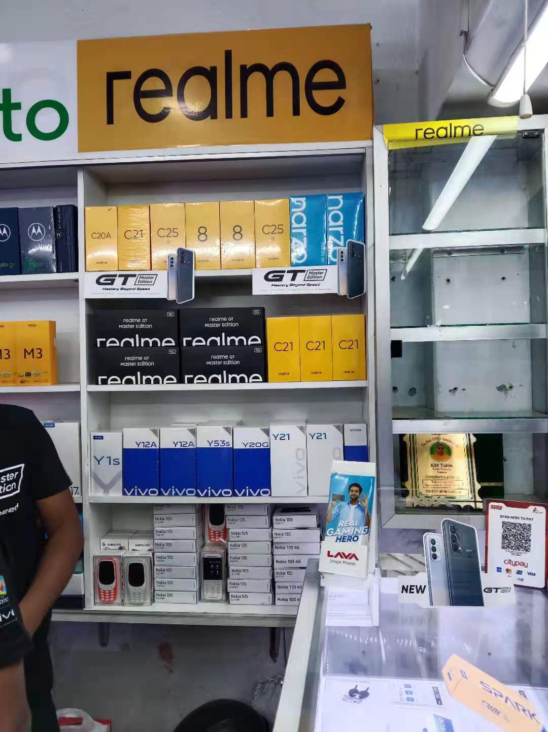
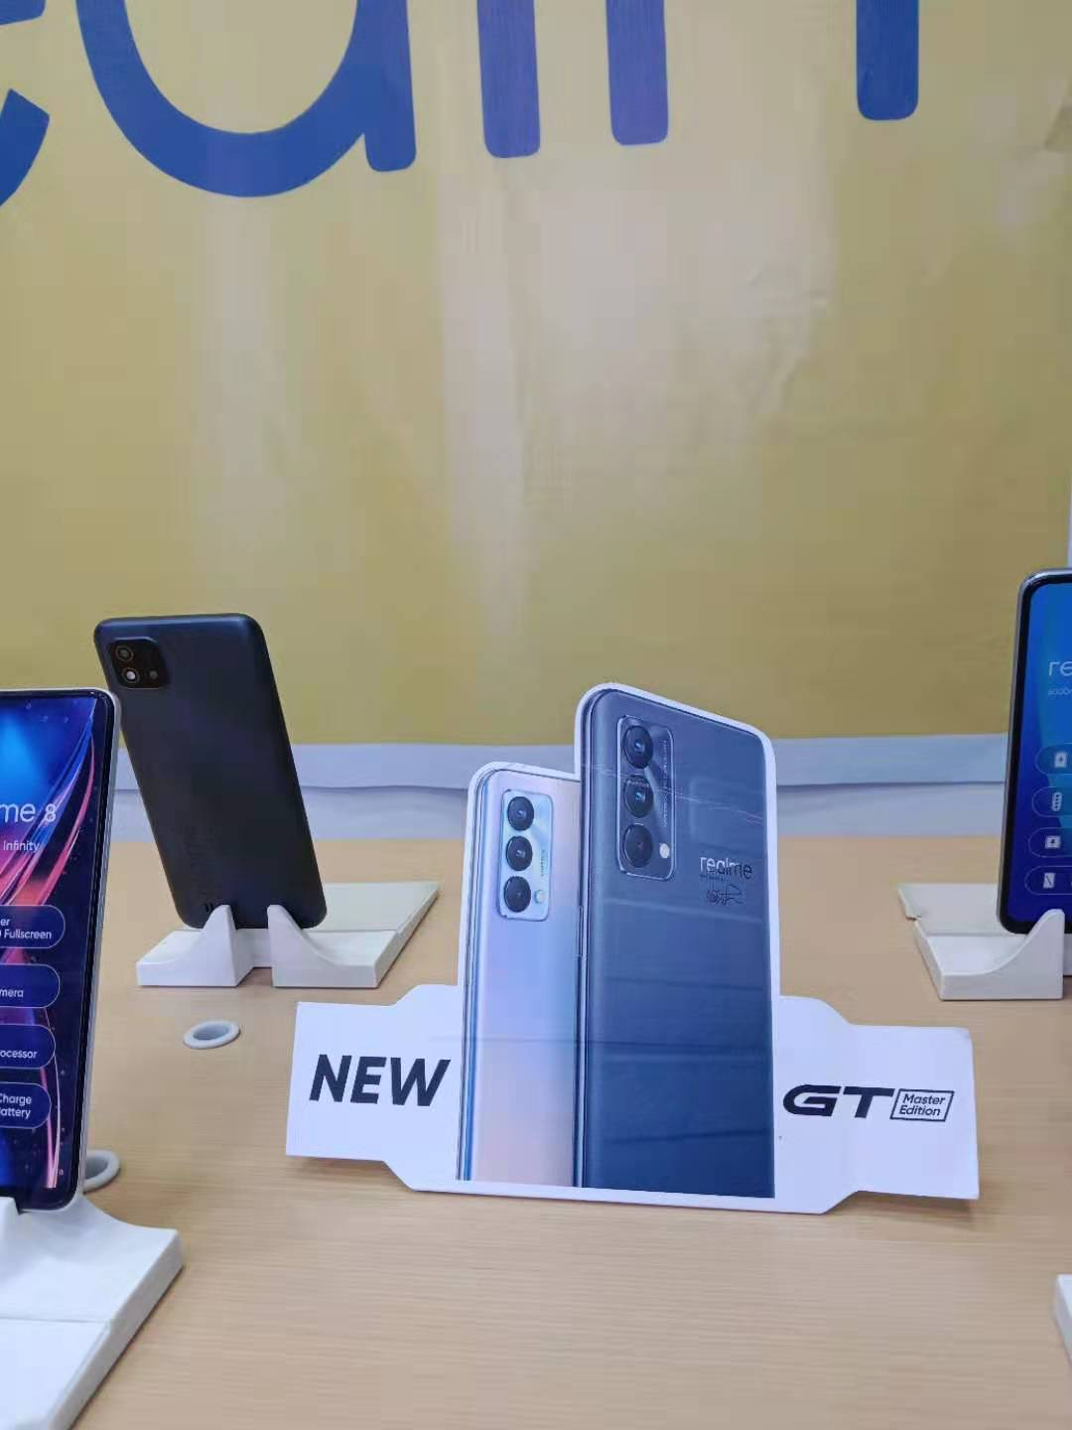
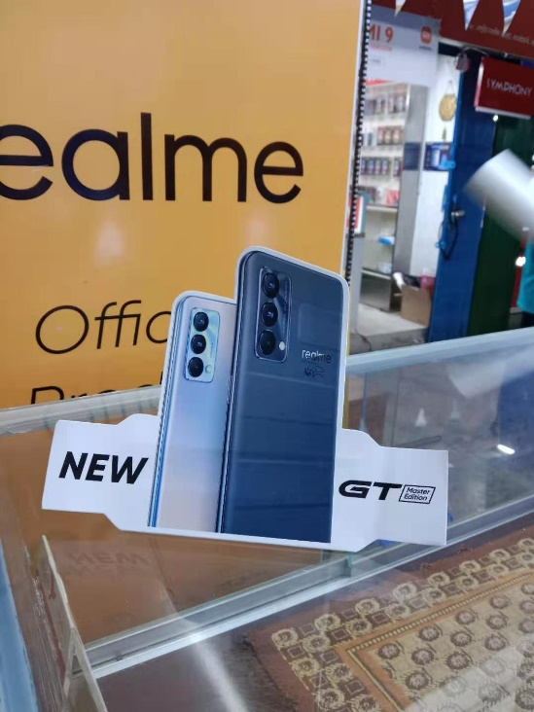
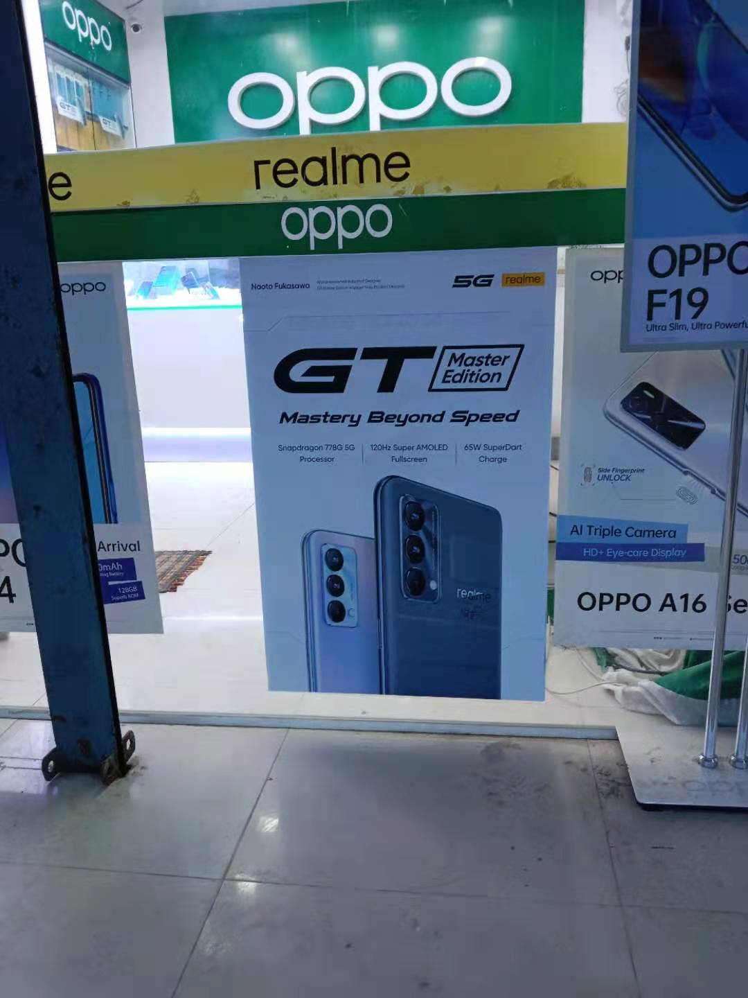
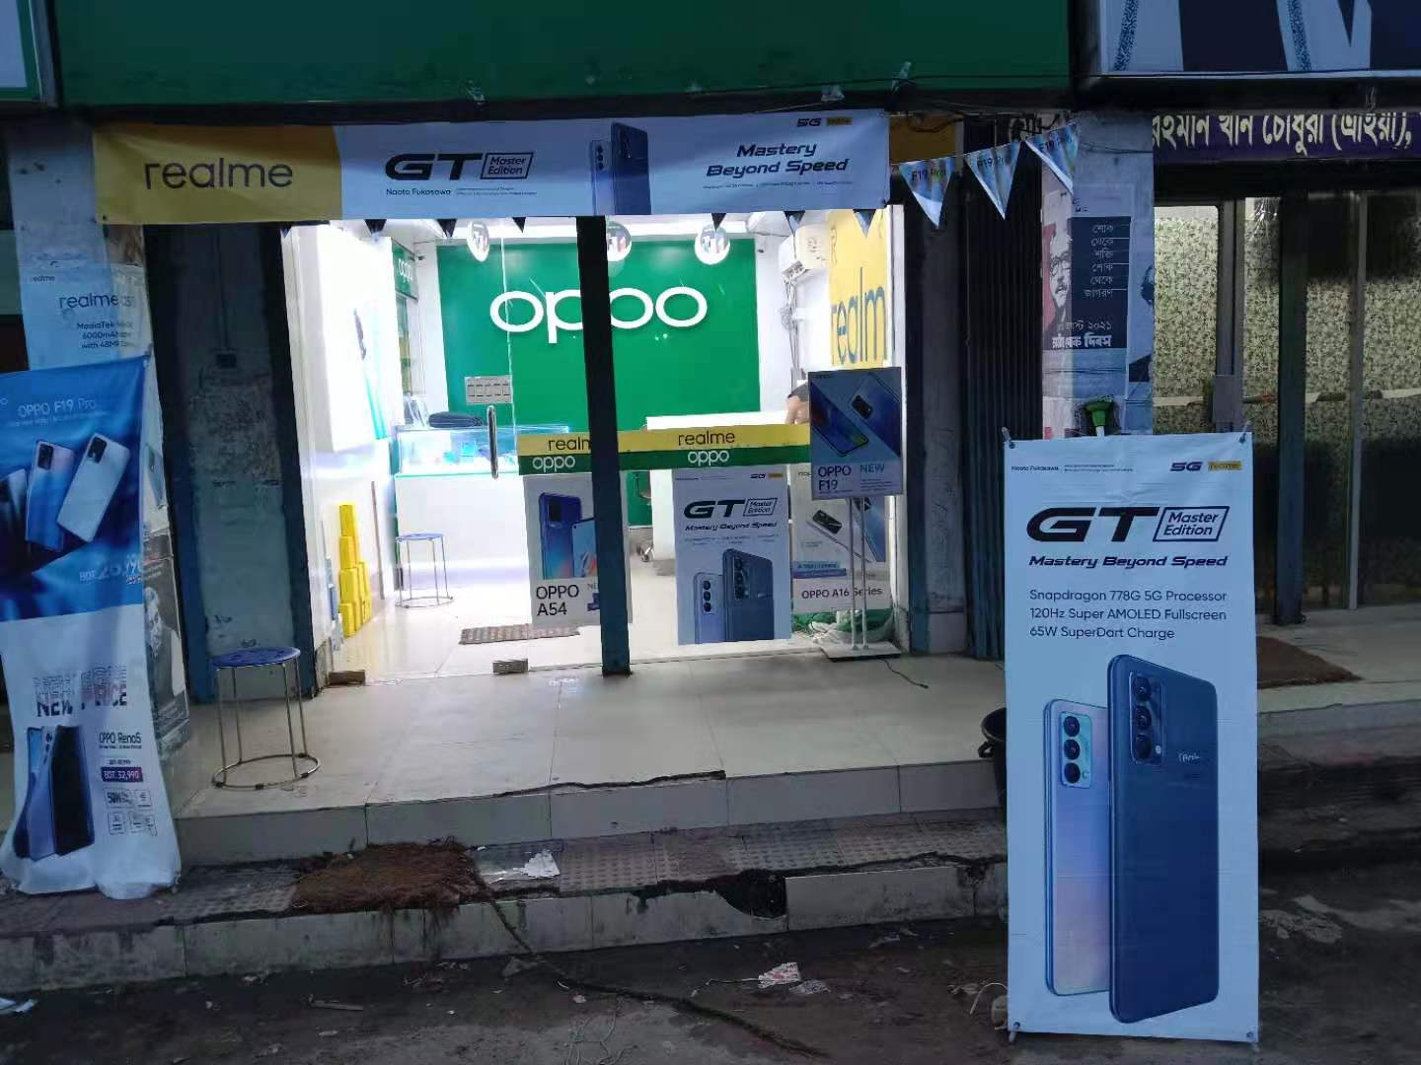
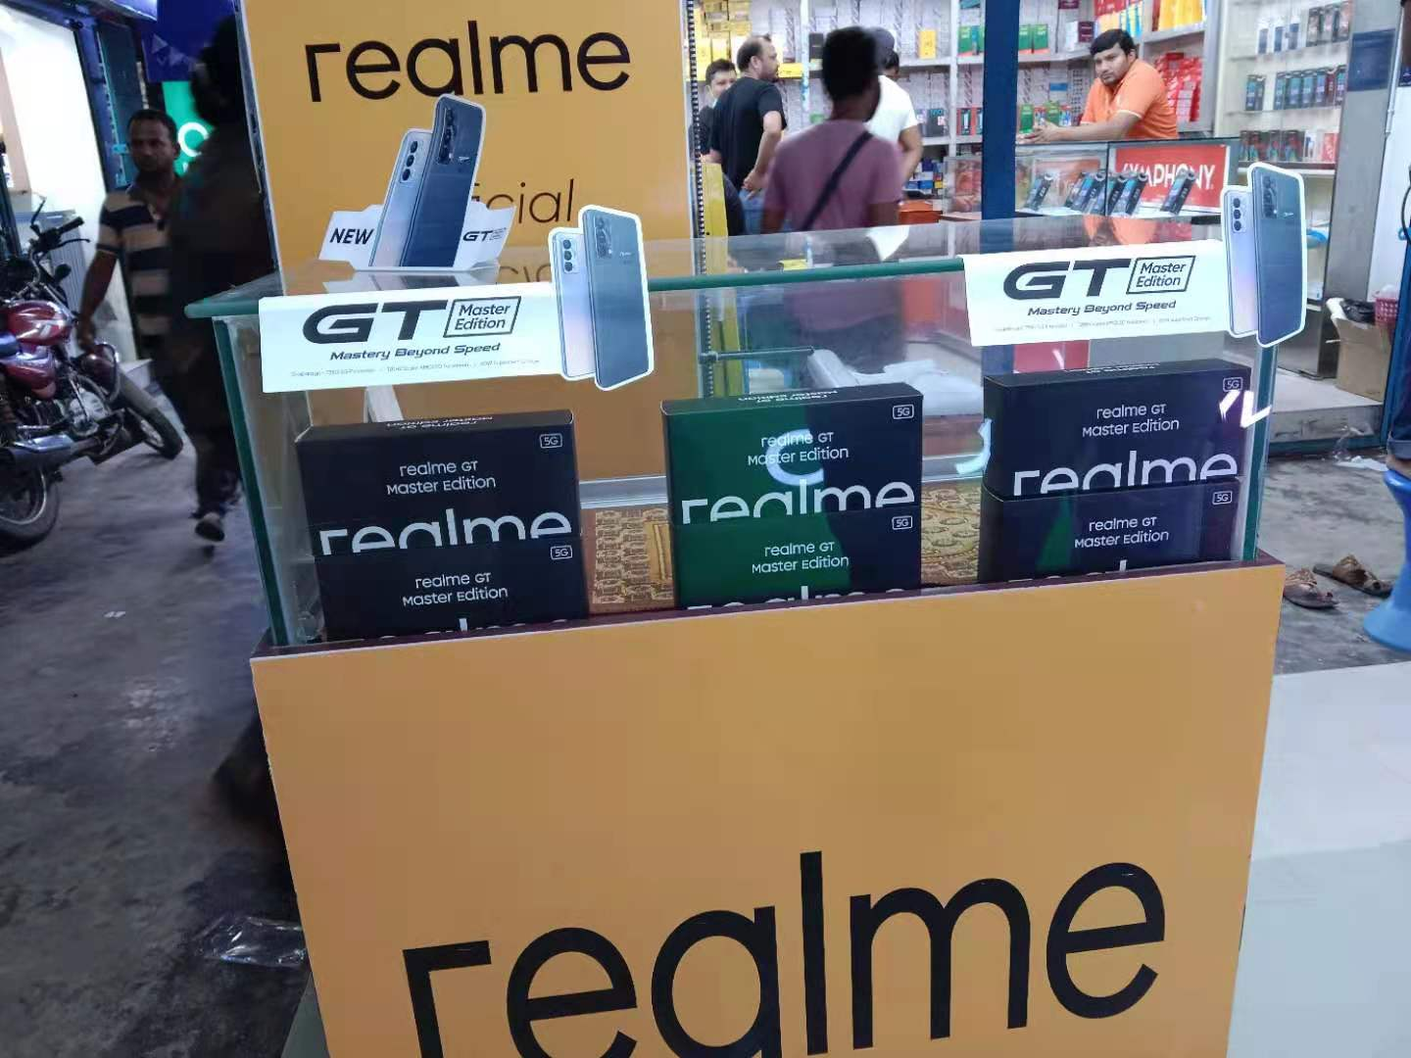
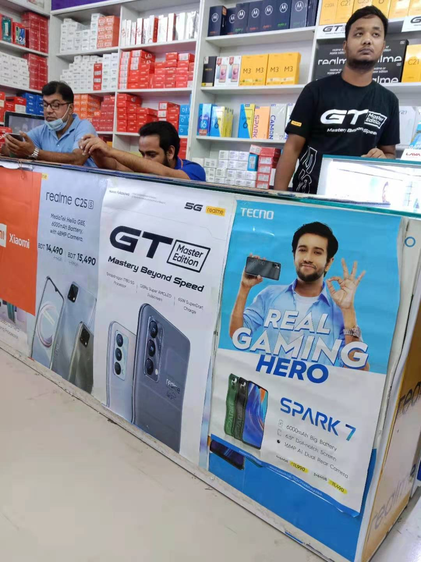

Slide 6
Thanks

